Slide 1
Group 8 Activity Recognition
By: Nikesh Ghimire, Jaffar Kadir, & Kevin Kowalski

Slide 2
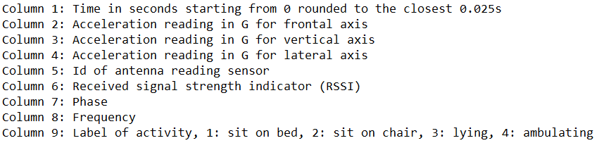
Dataset 7 Activity recognition with healthy older people using a batteryless wearable sensor
14 healthy participants between 66 and 86 years old
A sensor on the upper chest and several antennas around the rooms recorded the motion data, time, and activity.
Below is what was recorded and used in our models

Slide 3

Neural Network
The data was preprocessed with a simple min-max scale to fit all the variables between 0 and 1
Used only 1 hidden layer of 8 nodes to keep track of the important features while minding computational space and time
Training and testing accuracy of 97%

Slide 4
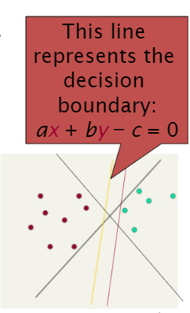
Support Vector Machines
Lots of possible solutions for a, b, c.
Some methods find a separating hyperplane, but not the optimal one [according to some criterion of expected goodness]
E.g., perceptron
Support Vector Machine (SVM) finds an optimal* solution.
Maximizes the distance between the hyperplane and the “difficult points” close to decision boundary
One intuition: if there are no points near the decision surface, then there are no very uncertain classification decisions

Slide 5
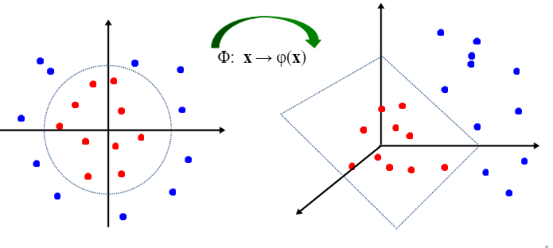
NON-LINEAR SVM
General idea: the original feature space can always be mapped to some higher-dimensional feature space where the training set is separable:
How should we know if the classes are linearly separable or non-linear separable?

Slide 6
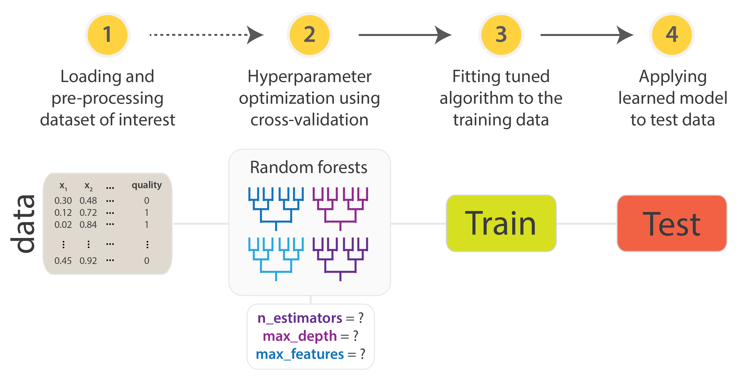
TUNING PARAMETER FOR BETTER PERFORMANCE
One challenges we faced here is the total running time of the model. Just running the simple model without tuning any parameters took us more than 15 minutes, and the accuracy was not as expected with an error percentage of nearly 40%.
Here are the parameter which are changed :
GAMMA
MARGIN

Slide 7
Pre-tuned
Post-tuned
A 1.237% improvement!

Slide 8
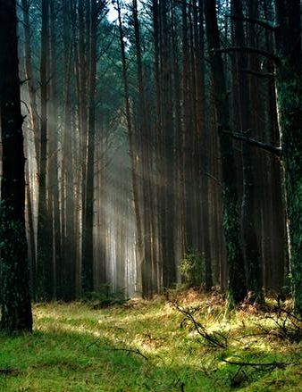
Random Forest
Used scikit-learn for modeling
Simple but slow
Initial classification was weak but hyperparameter tuning made a decent improvement

Slide 9

Hyperparameter Tuning
Default parameters for RandomForestClassifier() had an accuracy of 92.53% using 10-fold cross validation
Using scikit-learn’s RandomizedSearchCV(), hundreds of combinations of parameters were randomly selected and scored based on 10-fold CV
The best (found) parameters were outputted to be further tuned
The new parameters pushed the accuracy of the model to nearly 95% with an improvement of over 2%!

Slide 10
Even More Tuning
The now tuned score:
Attempt to tune by making small changes to the new parameters with a full grid search, but the improvement was negligible compared to the initial random search
The grid searched parameters did close to nothing at improving the accuracy
max_features and n_estimators affected the outcome the most and the random search seemed to have found the best options for the slot

Slide 11
Conclusion
The neural network and support vector machines reigned supreme over the random forest with about a 4% increase to accuracy on average
However, long train times plague SVM and the NN is limited by memory while random forest is simple to implement but costly to compute

